Slide 1
UBRS
UNDERSTANDING BEHAVIOUR
RESPONDING SAFELY
Minimising the use of physical restraint in schools

Slide 2
Safety and Wellbeing
UBRS is about developing the skills and systems necessary for responding safely to potentially dangerous situations
Using physical restraint creates the potential for a range of risks for students and teachers
Physical
Emotional and psychological
Relational
Reputational
Legal

Slide 4
What UBRS Is Not
It’s not restraint training
That’s MAPA training (Managing Actual or Potential Aggression)
provided to schools after all staff have received UBRS training
for a subset of staff in the context of specific students with IBPs

Slide 5
Who’s It For?
All staff, teaching and non-teaching, who may interact with students
Important foundational PD for managing behaviour
It’s not just for staff tasked with the more behaviourally challenging students
A full day’s training (1x 6hrs or 4x 90mins)

Slide 6
Why UBRS was Developed
Schools are committed to managing behaviour positively
Calls for advice about physical restraint and seclusion of students in the wake of a few serious incidents – there are some misunderstandings about what we can and cannot legally do
A cross-sector advisory group developed guidance that can be readily accessed by schools
Need for a focus on preventing challenging behaviours and if necessary, de-escalating the situation without the use of physical restraint
New guidelines and amendments to the Education Act
Notes:
6

Slide 7
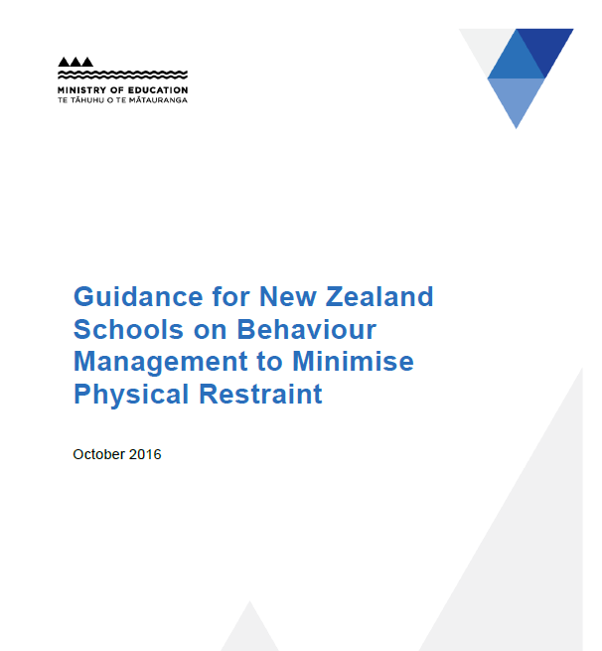

Slide 8
Teachers’ Rights, Duties and Vulnerabilities
When is the use of physical restraint legally justified?
When is it unjustified and hazardous to use physical restraint?
How does our duty of care fit with our right to a safe workplace?

Slide 9
Physical Restraint: From the guide
Restraint is “using your body to deliberately restrict the movement of another”
It may be justified when:
1) there is an imminent and clear threat to someone’s physical safety AND
2) it is used as a last resort when all other practicable, less-invasive options have been tried and failed AND
3) it is only used for the duration that the threat to safety exists

Slide 10
Physical Restraint: From the guide
Restraint is not justified:
for behaviour that disrupts the classroom but isn’t putting anyone in danger of injury
for refusal to comply
in response to verbal threats
to stop a student leaving the classroom or school without permission
as coercion, discipline or punishment
for property damage, unless the property itself could inflict injury

Slide 11
Overview of Modules
Understanding behaviour
Encouraging ready-to-learn behaviour
Responding
safely
Reflection and embedding
Behaviour has a function — a ‘why’
Understand the ‘why’ and you can respond constructively
How you can understand yourself and others
What you can influence
How to manage your reactions
What are the implications of the stress response
Differential responding
Understand levels of behaviour
What each level may look like
How to respond at each level
Practical strategies
Consolidate understanding
Embed learning into your context
Develop an action plan
Reflect on the concepts delivered
Managing safety and teaching
Effective learning environments
Relationships
Emotional regulation
Non-verbal strategies
Verbal strategies

